Slide 1
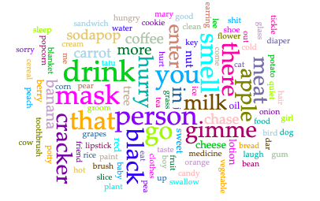
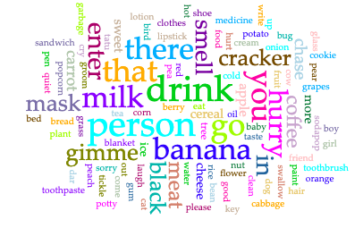
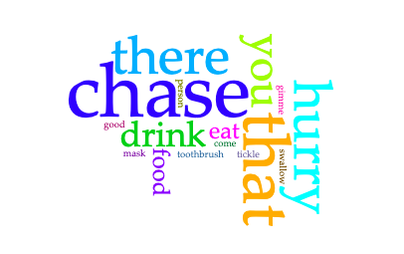
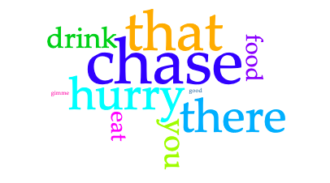
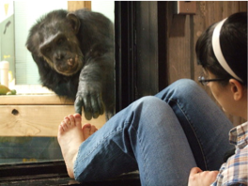
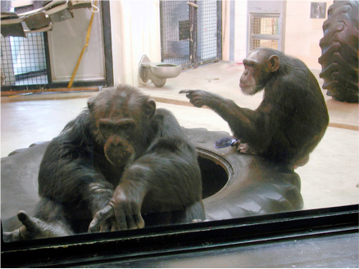
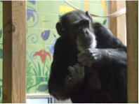
Persistence of Lexicon in Signing Chimpanzees
Emily Patton¹, Courtney Garzone¹, Jenna Skinner¹, Emilie Rich², Mary Lee Jensvold^{1,3,4}
¹Central Washington University ²University of Montreal ³Fauna Foundation ⁴Friends of Washoe
Introduction | Results | Conclusion
Five chimpanzees lived at Central Washington University (CWU) in Ellensburg, WA from 1980-2013. Washoe, Moja, Tatu, and Dar acquired American Sign Language (ASL) during their early years living under cross-fostering conditions^{1,2,3,4,5}. Loulis acquired his signs from the other chimpanzees⁶. In 2013, Tatu and Loulis moved to the Fauna Foundation (FF), a sanctuary in Carignan, Québec, Canada. All human caregivers at CWU were competent in ASL while at FF only a few caregivers used ASL. Tatu and Loulis continued to use ASL daily to converse with their human caregivers. At both locations caregivers maintained records of Tatu’s and Loulis’ daily vocabulary production on sign checklists. Sign checklists were lists of the signs that Tatu and Loulis used daily. When the caregiver observed each chimpanzee sign, she recorded that vocabulary item on the list. From 2014 to 2017 Tatu’s mean vocabulary items used in a day (M=14) was less than at CWU (M=19.75) from 2004 to 2007. Loulis’ remained the same for the two time periods (M=4)⁷. The current study explores Tatu’s and Loulis’ most recent vocabulary production in 2018 and 2019.
Table 1 shows that Tatu’s mean in this sample (M = 12) was lower than in the previous years at FF (M = 14) and Loulis’ was the same (M = 4). Tatu’s smallest range in the previous years was 1–32 in 2016 and this sample was comparable in 2018 but lower in 2019. Loulis’ range was lower in this sample than his lowest range in previous years (1-8 in 2015). The total number of vocabulary items per year was similar to previous years at FF, with a slight increase for both chimpanzees as compared to 2015 and 2016. Figure 1 shows that high frequency signs for both chimpanzees were nearly identical to previous years at FF. While Tatu’s and Loulis’ sign use changed slightly in their transition from CWU to FF, it remained consistent during their time at FF. This data indicates that ASL use in chimpanzees is a robust behavior that persists throughout environments.
 |  | 2018 | 2019
Tatu | Range | 1-32 | 1-26
 | M | 12 | 12
 | ∑ | 3666 | 3698
Loulis | Range | 1-7 | 1-7
 | M | 4 | 4
 | ∑ | 1067 | 938
Table 1: Sign Range and Mean Per Day and Total Signs Per Year
Acknowledgements
2018
2019
We would like to thank the staff at Fauna Foundation for their maintenance of the sign logs and Friends of Washoe and the Winley Foundation for supporting signing caregivers. We would also like to thank E. Chadwick de Bree for his contributions to this project.
Methods
We used sign checklists from 2018 and 2019. For each year we calculated the mean number and range of vocabulary items each chimpanzee made in a day, and the sum of items recorded for each year. We generated word clouds using Voyant Tools software (voyant-tools.org).
Tatu
References
1. Bodamar, M. D., & Gardner, R. A. (2002). How cross-fostered chimpanzees (Pan troglodytes) initiate and maintain conversations. Journal of Comparative Psychology, 116(1), 12-26.
2. Gardner, R.A. & Gardner, B.T. (1989). A cross-fostering laboratory. In R. A. Gardner, B. T. Gardner, & T. E. Van Cantfort (Eds.) Teaching sign language to chimpanzees (pp. 1-28). Albany, NY: State University of New York Press.
3. Jensvold, M. L. A., & Gardner, R. A. (2000). Interactive use of sign language by cross-fostered chimpanzees (Pan troglodytes). Journal of Comparative Psychology, 114(4), 335-346.
4. Leeds, C. A., & Jensvold, M. L. A. (2013). The communicative functions of five signing chimpanzees (Pan troglodytes). Pragmatics & Cognition, 21(1), 224-247.
5. Leitten, L., Jensvold, M. L. A., Fouts, R. S., & Wallin, J. M. (2012). Contingency in requests of signing chimpanzees. Interaction Studies, 13(2), 147-264.
6. Fouts, R.S., Hirsch, A.D., & Fouts, D.H. (1982). Cultural transmission of a human language in a chimpanzee mother-infant relationship. In H.E. Fitzgerald, J.A. Mullins, & P. Gage (Eds.), Child Nurturance: Studies of Development in Nonhuman Primates (Vol. 3, pp 159-193). New York, NY: Plenum Press.
7. Jensvold, M. L. & Dombrausky, K. (2019). Sign language in chimpanzees across environments. In M. L. Jensvold (Eds.), Chimpanzee behaviour: Recent understandings from captivity and the forest (141-169). New York, NY: Nova Science.
Loulis
Figure 1: Most Frequently Used Vocabulary Items

